Slide 1





Unleashing Creativity Using
AI Agent Networks
Mihaela van der Schaar, FRS John Humphrey Plummer Professor of Machine Learning, Artificial Intelligence and Medicine, University of Cambridge
Director, Cambridge Center for AI in Medicine
mv472@cam.ac.uk
@MihaelaVDS
vanderschaar-lab.com
linkedin.com/in/ mihaela-van-der-schaar/

Slide 2
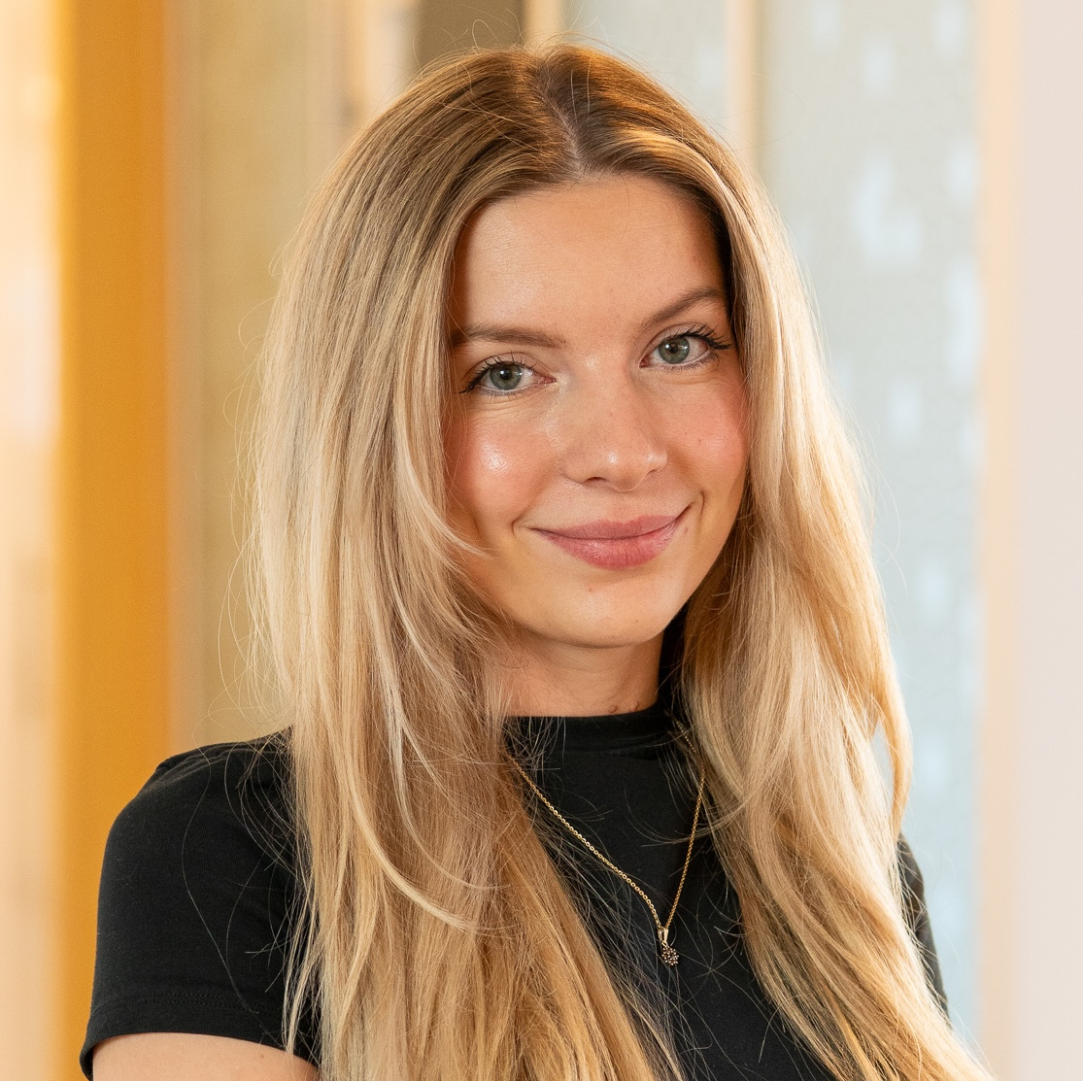
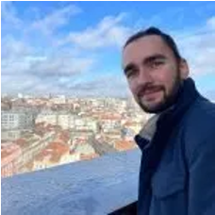
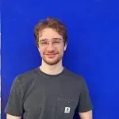
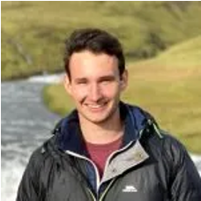

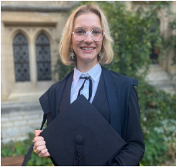
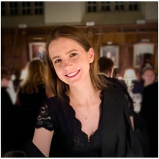
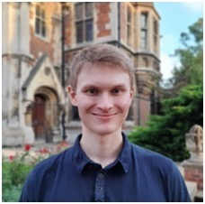
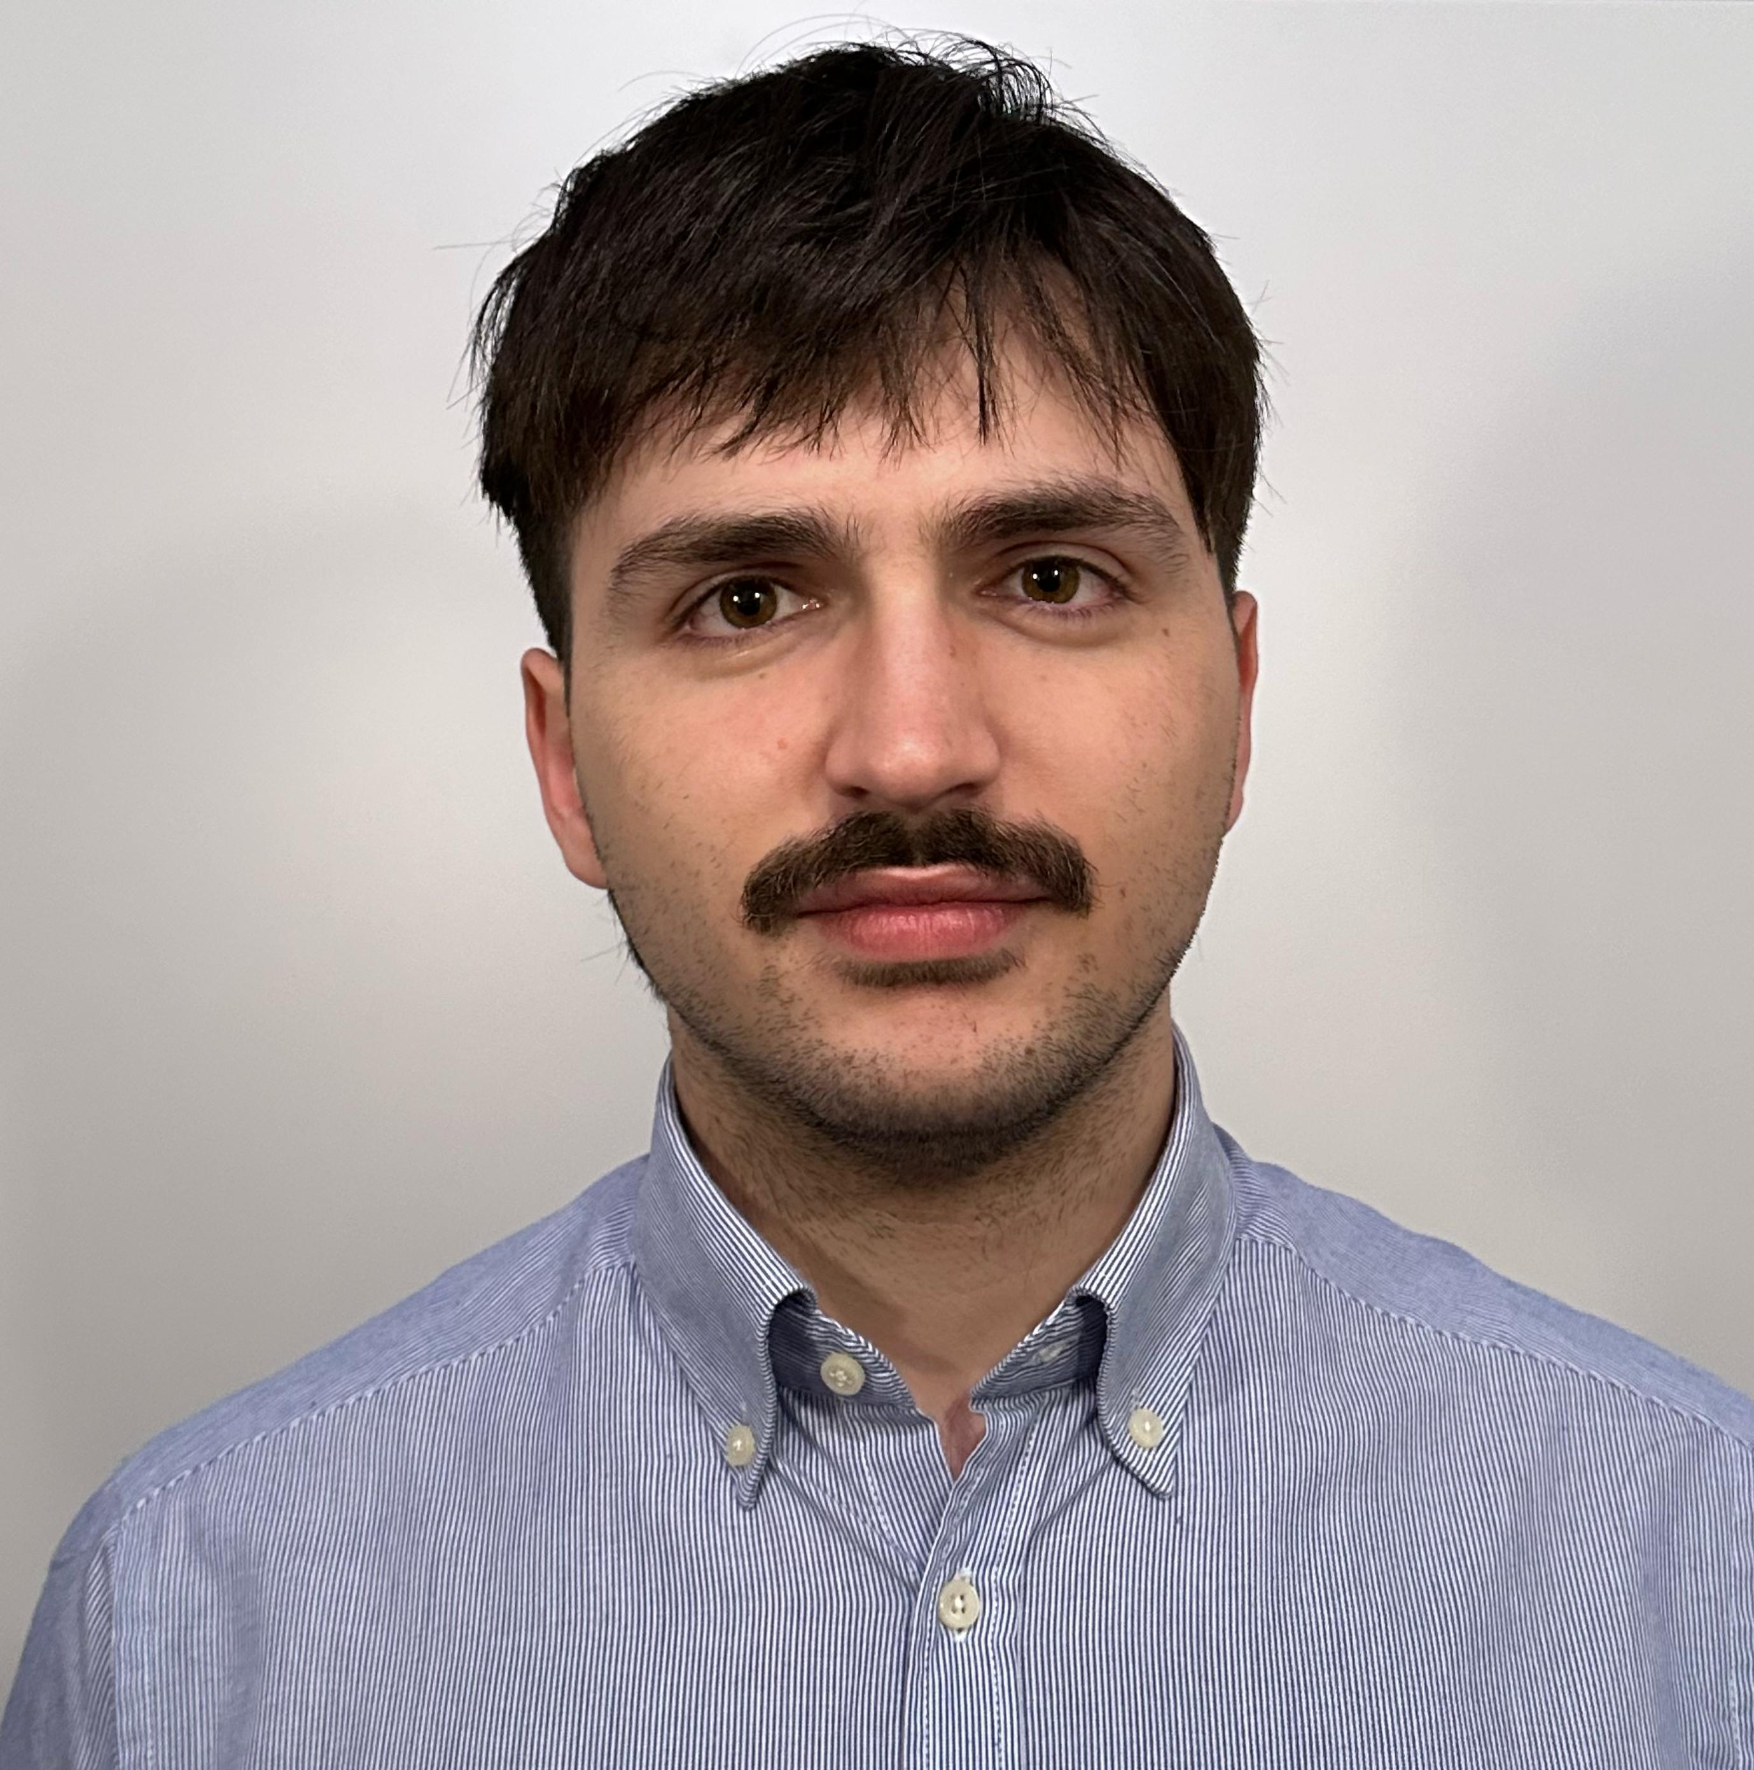
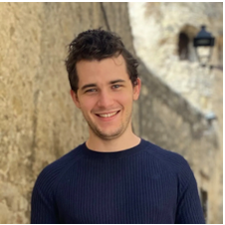

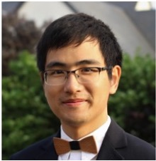
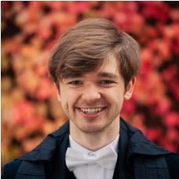
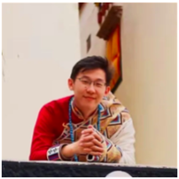
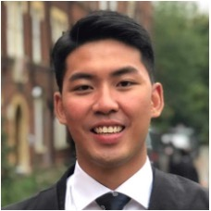
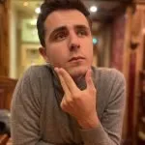

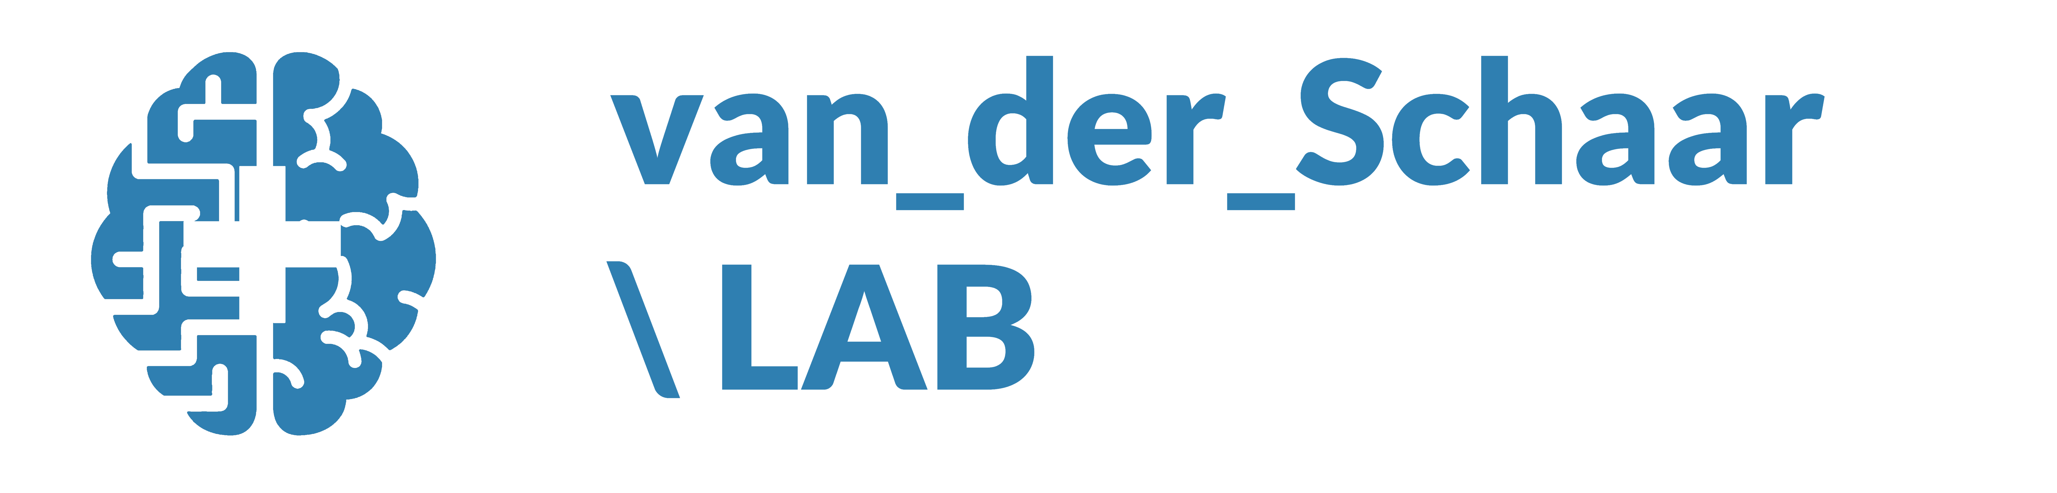

Meet our group!
https://www.vanderschaar-lab.com/
Research Team
= joined us in 2025
Anita Kriz
Antonin Berthon
Benjamin Lapostolle
Claudio Fanconi
Harry Amad
Julianna Piskorz
Kasia Kobalczyk
Krzysztof Kacprzyk
Luca Muscarnera
Max Ruiz Luyten
Nicolás Astorga
Nicholas Huyn
Paulius Rauba
Qiyao Wei
Tennison Liu
Thomas Pouplin
Victor Baillet
vanderschaar-lab.com

Slide 3
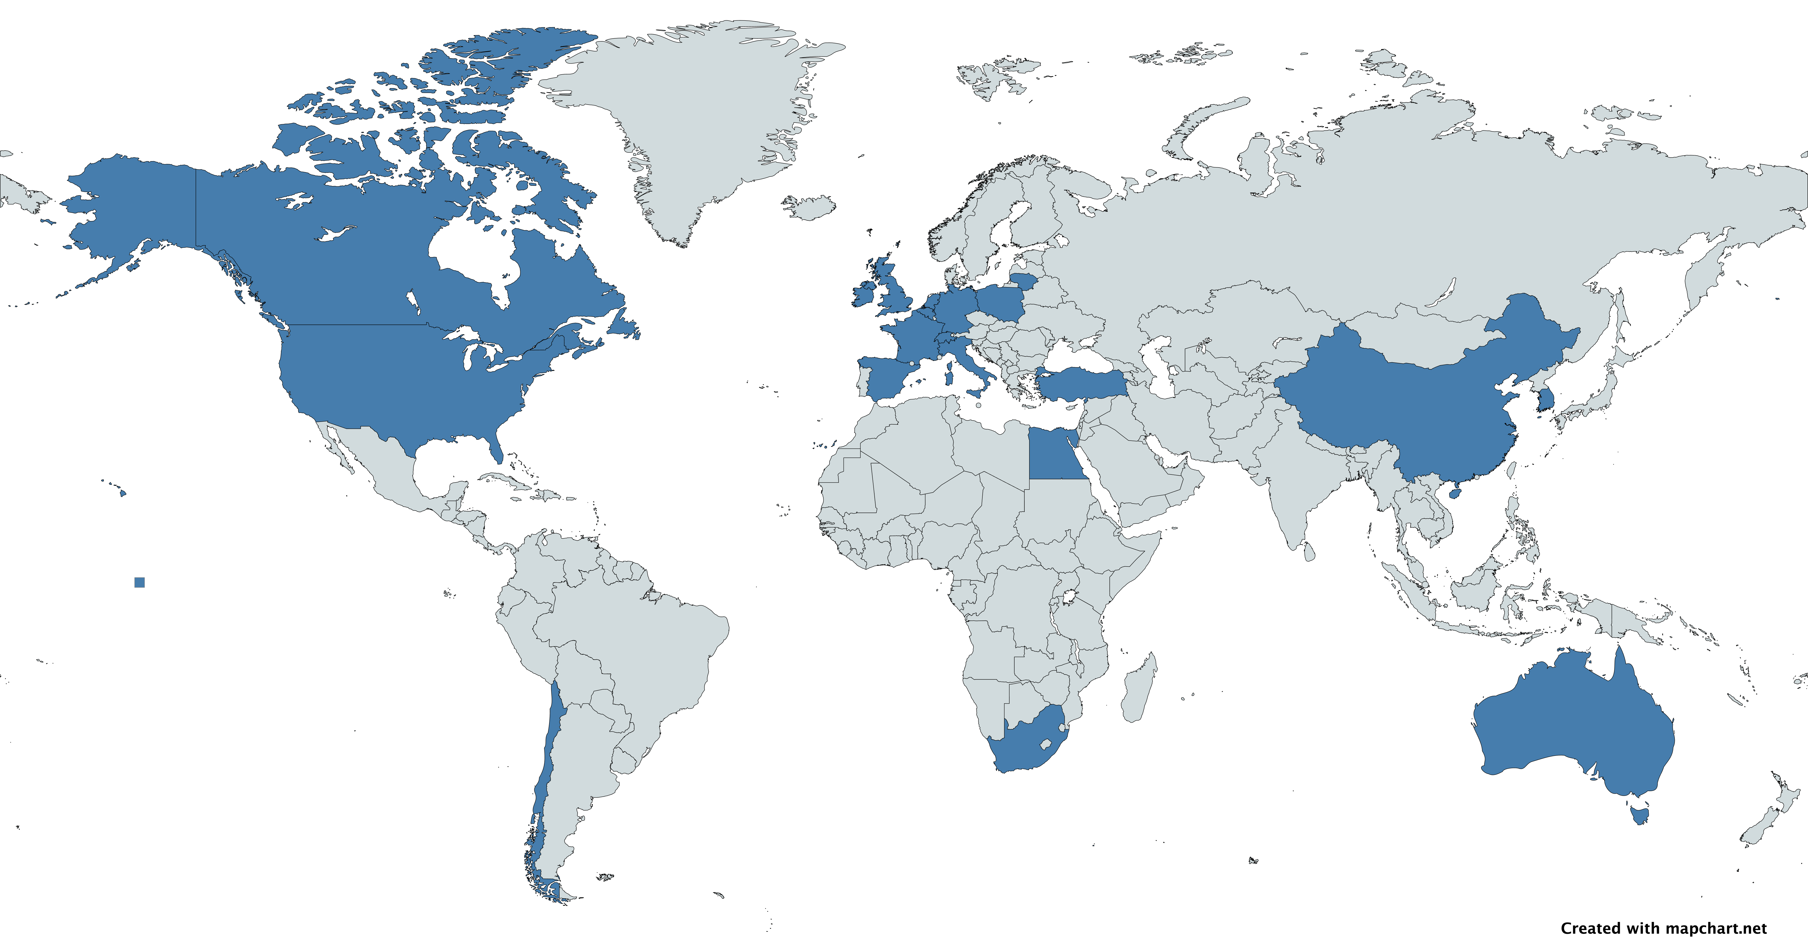
Our lab – diverse and international
From over 20+ countries, from diverse academic backgrounds
Economists
Statisticians
Mathematicians
Computer Scientists
Physicists
Engineers
vanderschaar-lab.com

Slide 4

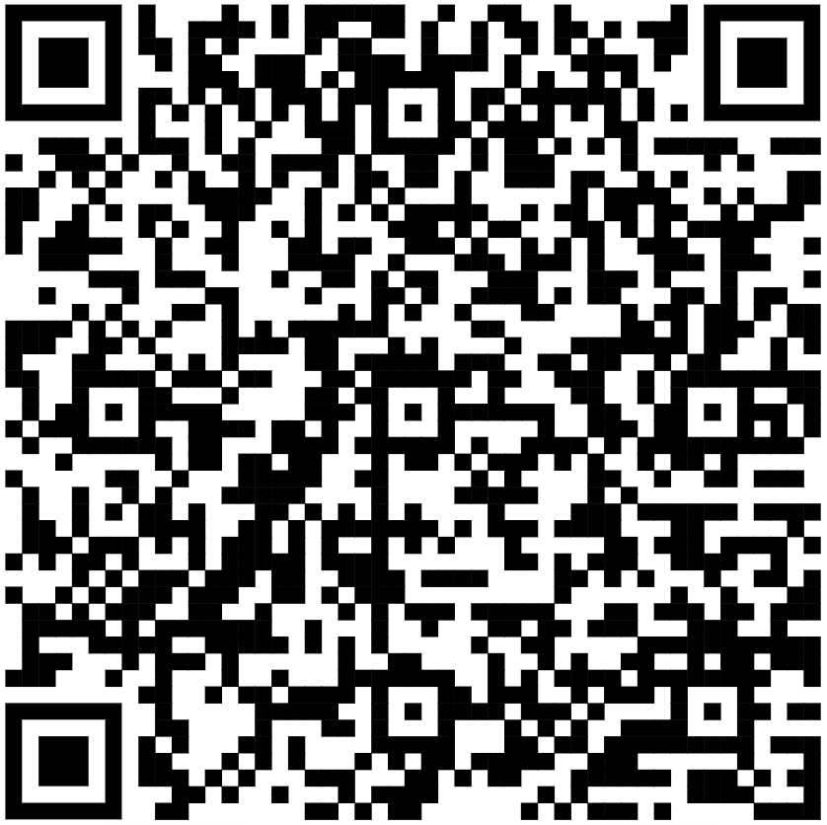
A fundamentally new paradigm is needed for AI to orient it towards addressing the complexities of the real-world
vanderschaar-lab.com

Slide 5
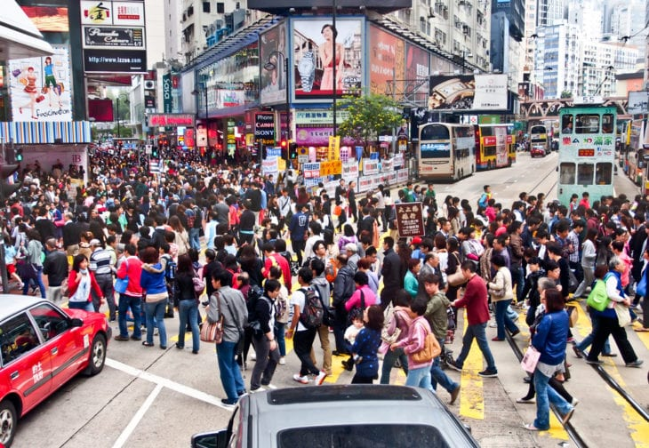
What is Reality-centric AI?
AI which aims to solve real-world problems
AI which operates effectively and accountably given the inherent and unavoidable complexities of the real world
AI which empowers, and does not marginalize humans
vanderschaar-lab.com
Notes:
Problem first, not method first
Currently the ML world is too much focused on solving “standardized” problems, at times toy problems and focuses on developing incremental methods working on benchmarks
We need a new way of thinking – focused on understanding, formalizing and addressing complex, intricate, real-world problems using AI/ML

Slide 6
Our focus
Identify big and bold problems we want to solve – societal, healthcare, education, finance, economics, biology etc.
Define and formalize the identified problems
Invent cutting-edge ML solutions to solve them
But there is a gap….because most of these problems are complex & not tractable
This also requires out-of-the-box thinking, modeling and new ML to close the gap
vanderschaar-lab.com
Notes:
Model input
Model output
Model ecosystem

Slide 7

Fearless thinking
We are interested to envision a better world and then develop new ways of thinking and new ML to conceive it
A huge challenge!
Brain-hurting difficult!
Exciting!
Intellectual adrenaline ☺
A sense of achievement
vanderschaar-lab.com
Notes:
Model input
Model output
Model ecosystem

Slide 8
Different types of research labs
Most ML/AI Research Labs
Our way
Work on well-formalized problems, well-known benchmarks
Focus on the same problem for many years
Build on established work
Use similar methods repeatedly
All work in the same sub-area of ML
Create excitement through the development of new algorithmic possibilities
Focus on transformation in the real-world, create new ways of thinking, newly defined problems
Formalize new, unique challenges
Different problems require diverse methods and new strands of ML
Explore multiple areas of ML, beyond a single sub-area
Create excitement through groundbreaking possibilities

Slide 9
ML topics
AI Agents: Creativity, Reasoning, Safety, Collaboration, Labor Markets
AI for Scientific Discovery
Synthetic data, simulators and generative models
Digital Twins
Decision making under uncertainty
Next-generation RL
Causal Inference
Time series
AI-human alignment, AI for human empowerment
AI for complex systems, organizations
Autoformalism
AI for Operations Research
AI for Education
Etc.
vanderschaar-lab.com
Notes:
Model input
Model output
Model ecosystem

Slide 10
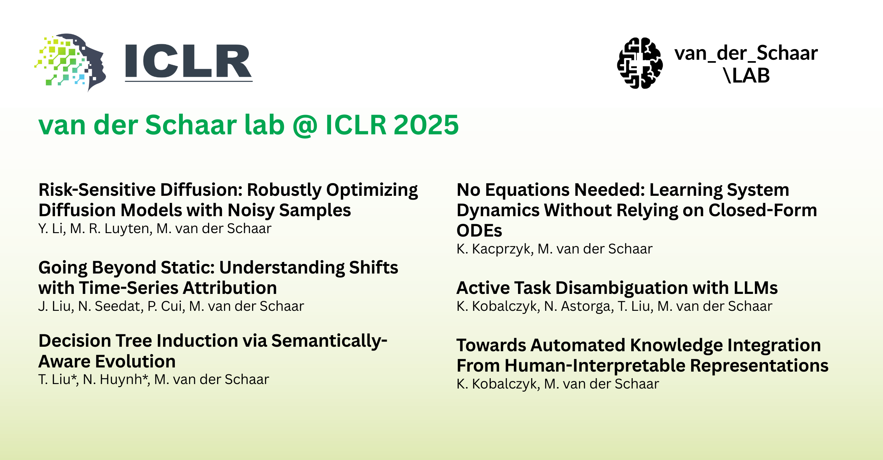
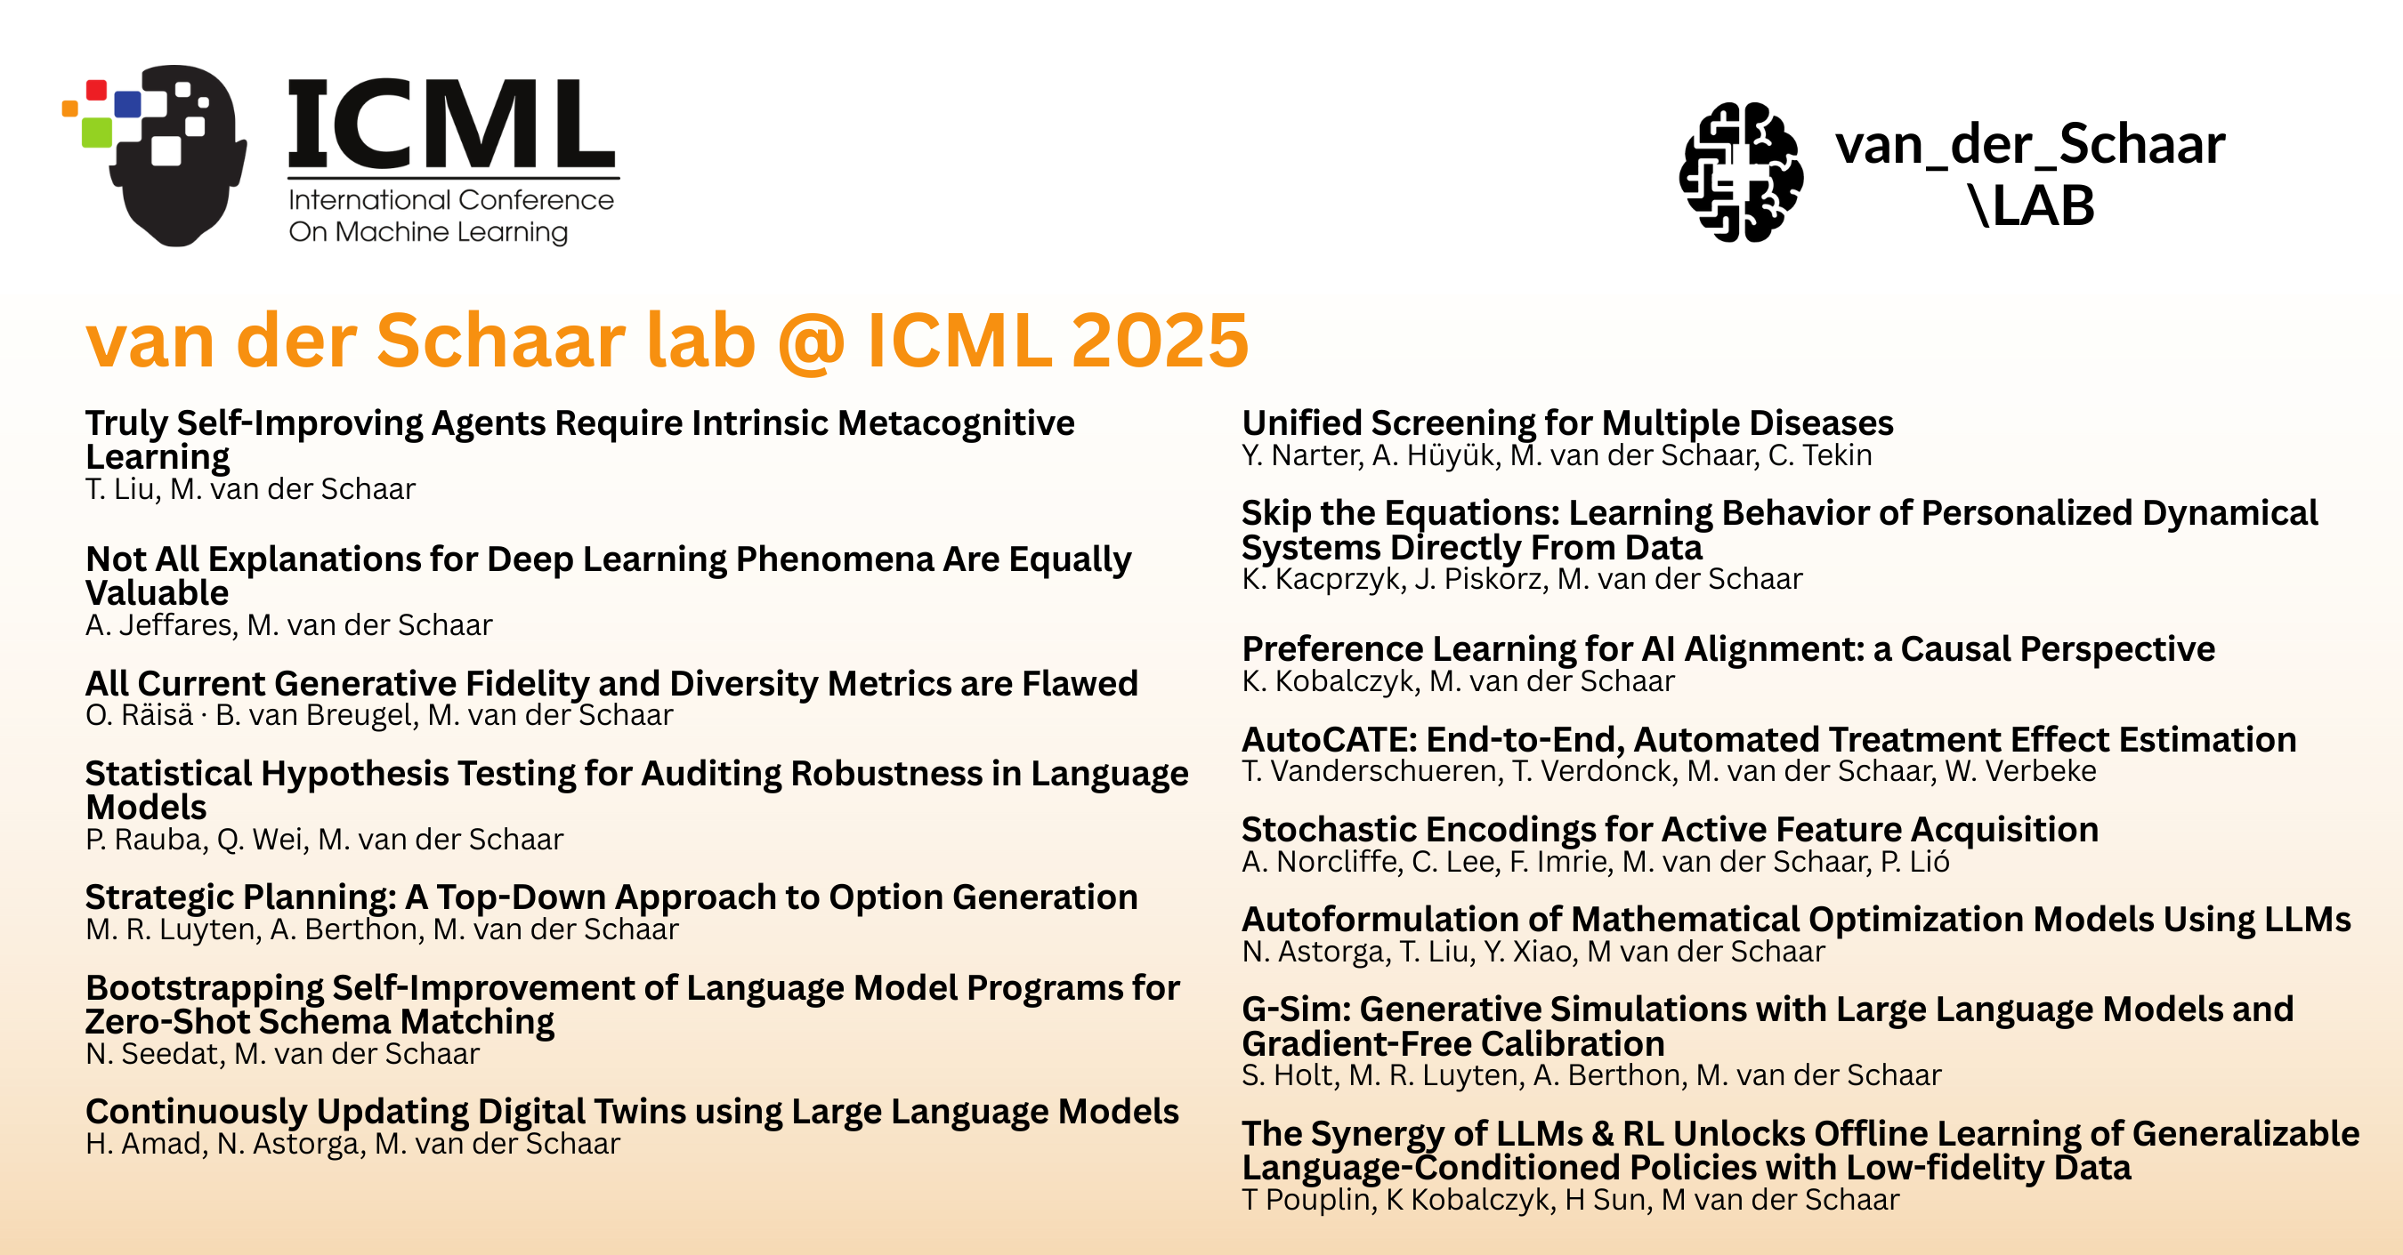
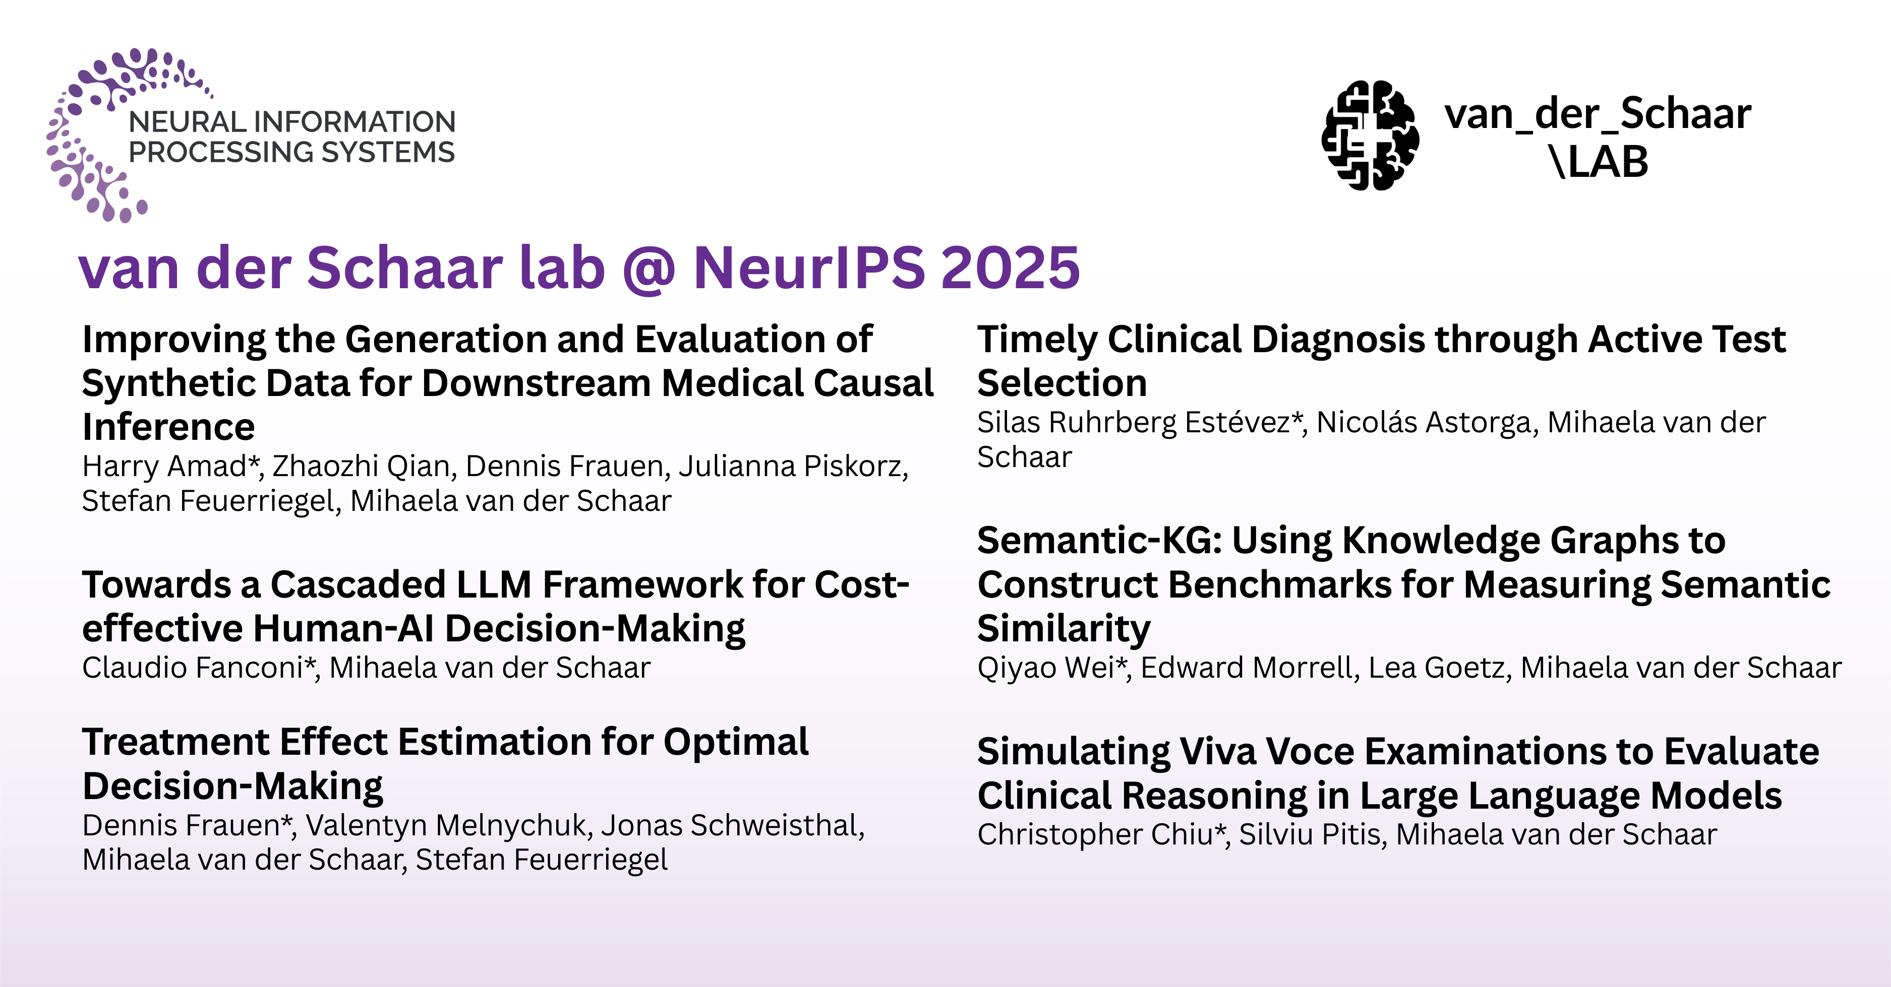
van der Schaar lab @ NeurIPS, ICML, ICLR 2025
https://www.vanderschaar-lab.com/
Publications
32 papers published in 2025 at the best AI/ML conferences
vanderschaar-lab.com

Slide 11
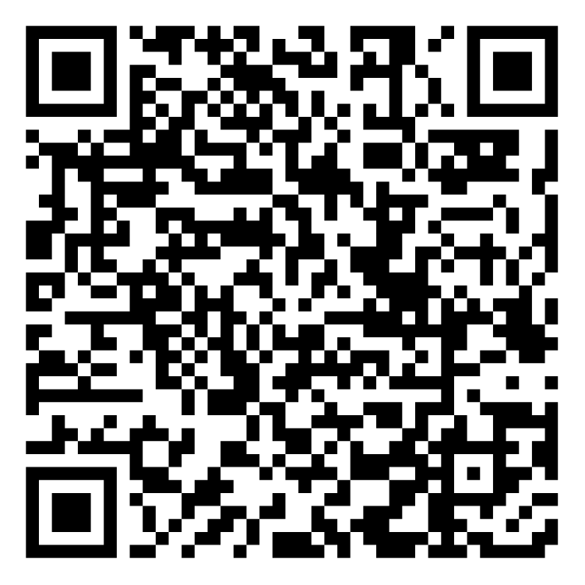
PhD Opportunities at the van der Schaar Lab
We are looking for 4 fully funded PhDs to join our lab! Applications now OPEN!
About our PhD programme
Based at the University of Cambridge (DAMTP)
Work at the cutting edge in a world-leading lab
Projects with a purpose; work that can change the world
32 papers accepted at four largest AI/ML conferences (NeurIPS, ICML, ICLR, AISTATS) in the past year
Join our PhD Open Day
Monday 20 October, 9:30am (BST) (virtual)
Hear from current PhD students, explore research areas, and ask questions
Apply through our website:
www.vanderschaar-lab.com/join-the-van-der-schaar-lab/
Scan the QR code to register for the PhD Open Day:
For any queries, please email: vanderschaarlab@damtp.cam.ac.uk
vanderschaar-lab.com

Slide 12
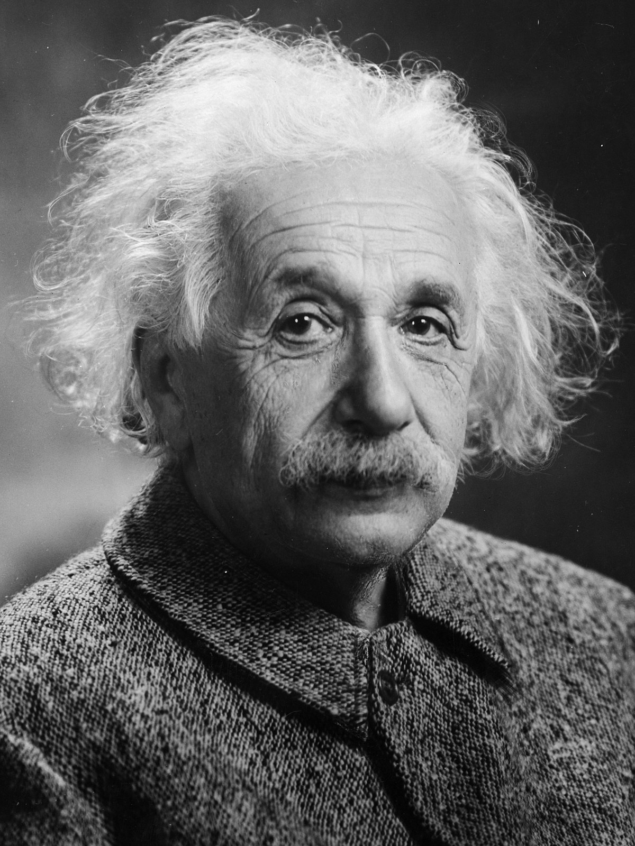
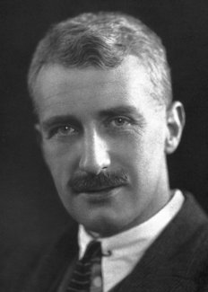
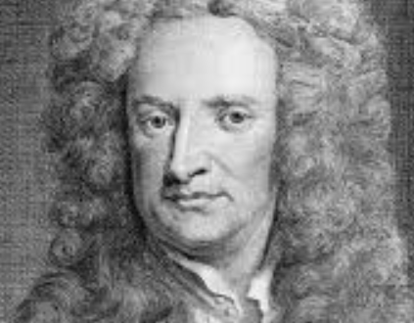
Scientific discovery in the era of AI
🔹 If Einstein had access to powerful AI, would he still have needed intuitive leaps or would AI have led him directly to relativity? 🔹 Could AI agents reveal laws of nature that even the greatest human minds (Einstein, Hill, Newton) could never have grasped alone? 🔹 In an era of AI-driven discovery, do scientists remain the explorers or are we becoming interpreters of insights unearthed by our digital counterparts? 🔹 Will creativity in science shift from deriving answers to framing the most meaningful questions? 🔹 Are we approaching an age where discovery emerges from symbiotic human–AI partnerships where AI collaborates with us, rather than replace us? 🔹 And if so, what does it mean to be a scientist when knowledge itself can now be generated, reasoned, and evolved by AI agents?
vanderschaar-lab.com

Slide 13
This talk
We are entering a new paradigm of discovery, driven not by static models or datasets, but by AI agents capable of reasoning, experimentation, and evolving knowledge, transforming science from human-centric to co-creative
LLM-based AI Agents
Why are they exciting
Examples
Genies: Next-generation AI Agents
Networks of Autonomous Scientific Agents
Join forces with us
vanderschaar-lab.com
Notes:
I would like to end with a call to action: Let us build AI that is human-empowering

Slide 14


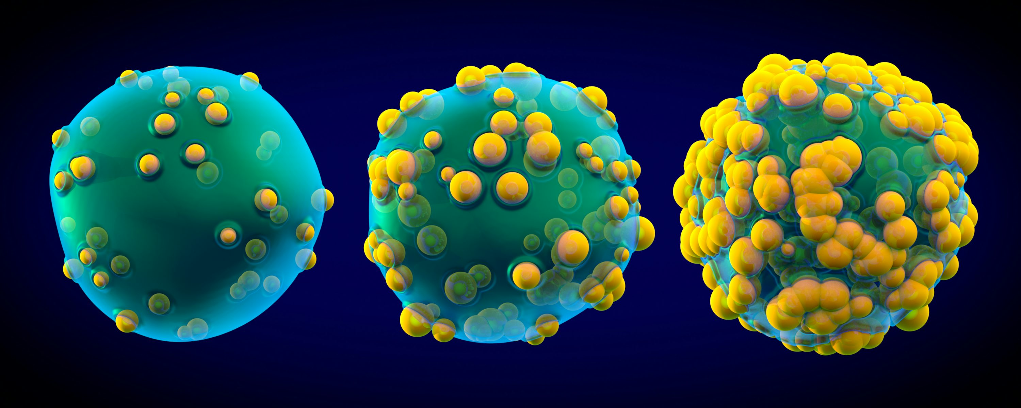

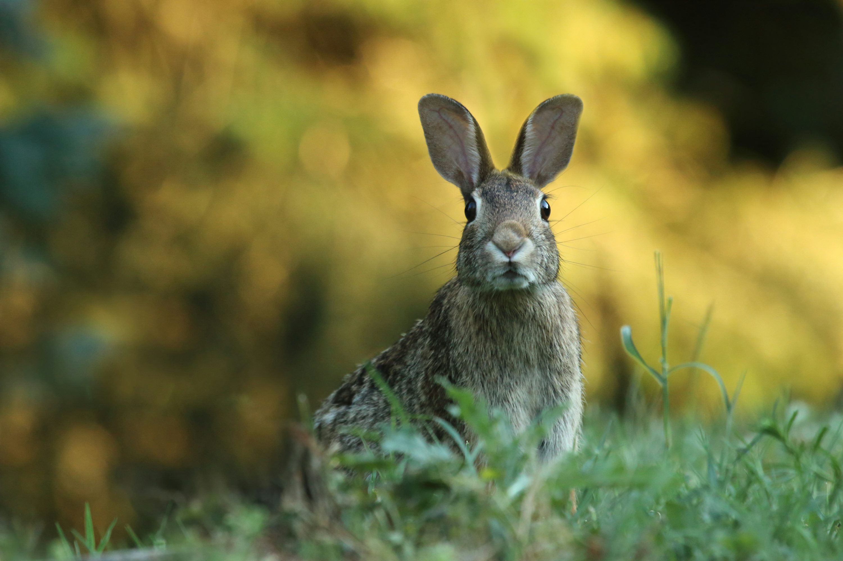
Discovering scientific laws
Uncovering the Fundamental Laws Governing System Evolution Over Time
Why do we care?
Applications: Medicine, Physics, Finance, Climate, etc.
vanderschaar-lab.com
Notes:
Identifiability, interpretability
Can you draw a connections btween AI for discovery, and Spinoza’s natural laws. If if is obvious to you still spell it out to connect the dots.

Slide 15
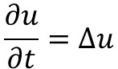
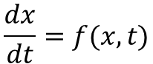
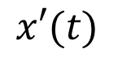
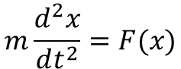
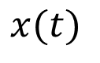
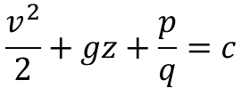
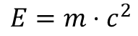
A hard problem
Discovery of governing equations using ML
 | Explicit function | Ordinary differential equation | Partial differential equation
Typical form
Examples
$$\frac{dx}{dt}=f(x,t)$$
$$m\frac{d^{2}x}{dt^{2}}=F(x)$$
$$\frac{∂u}{∂t}=Δu$$
$$E=m⋅c^{2}$$
$$\frac{v^{2}}{2}+gz+\frac{p}{q}=c$$
ODE
$$x(t)$$
$$x′(t)$$
vanderschaar-lab.com
Notes:
An ODE links the function and its derivative.
Dyn sys – evol of sys- key problem in medicine

Slide 16
Why do we care about ODEs?
Almost everything in medicine is a dynamical system
1. Pharmacokinetic (PK) Models
2. Pharmacodynamic (PD) Models
3. Physiological-Based Pharmacokinetic (PBPK) Models
4. Homeostatic Regulation Models and Non-Homeostatic models
5. Epidemic and Population Dynamics
6. Biochemical Pathway Models
7. Physiological Models
vanderschaar-lab.com
Notes:
Dynamical systems are often modeled using differential equations that describe how the state of the system changes over time.

Slide 17
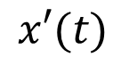
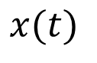
To describe dynamical systems, we need
Differential equations
Equations that involve derivatives
Commonly used to describe continuous-time dynamical systems
Describe the change in infinitesimal time (time derivative)
E.g. Ordinary DE
ODE
Learning ODEs from data:
A hard problem
$$x(t)$$
$$x′(t)$$
vanderschaar-lab.com
Notes:
Dynamical systems are often modeled using differential equations that describe how the state of the system changes over time.

Slide 18


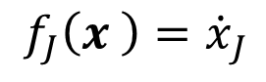
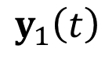
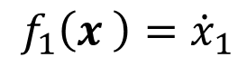
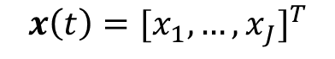
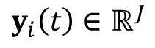
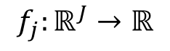
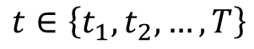
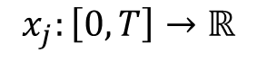
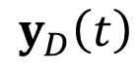
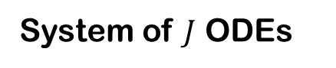
Problem formulation
Machine Learning Algorithms
Dataset
System of $J$ ODEs
Dataset
$$f_{1}\left(x \right)={\dot{x}}_{1}$$
$$y_{1}\left(t\right)$$
Goal:
Discover
.
.
.
.
.
.
$$y_{D}\left(t\right)$$
$$f_{J}\left(x \right)={\dot{x}}_{J}$$
discover
$$t∈\left\{t_{1},t_{2},…,T\right\}$$
$$x_{j}:\left[0,T\right]→ℝ$$
Structural knowledge
$$y_{i}\left(t\right)∈ℝ^{J}$$
$$x\left(t\right)={[x_{1},…,x_{J}]}^{T}$$
additional insight
$$f_{j}:ℝ^{J}→ℝ$$
vanderschaar-lab.com

Slide 19
Why is discovering ODEs from data challenging?
The time derivative is not observed
Only observe the states over time
Conventional symbolic regression methods are not applicable
It is difficult to estimate the time derivative
States are observed sporadically with noise
Naïve two-step symbolic regression is likely to fail
Difficulty in directly solving the initial value problem of ODE
The true initial condition is unknown & difficult to infer
Sensitive to initial condition
Computationally challenging
vanderschaar-lab.com

Slide 20
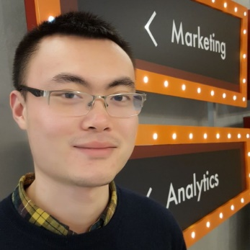
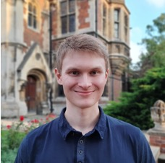
Discover closed-form ordinary differential equations (ODEs) from observed trajectories - D-CODE
Z. Qian, K. Kacprzyk, M. van der Schaar,
ICLR 2022
Machine Learning Algorithms
Dataset
discover
Zhaozhi Qian
Krzysztof Kacprzyk
Structural knowledge
additional insight
vanderschaar-lab.com
Notes:
Discover -> human -> Structural knowledge
Paper – ICLR, etc. include works that are not in the thesis
Data coming?
Closed loop framework
First, one can start with structural knowledge
ML - Link sub-systems
Adding explanatory variables
Infer unobserved state variables
Correct misspecified expert equations
Better performance – what performance?
Second
Automated and algorithmic
Data driven
Existing methods
Strict and unrealistic assumption
Sensitive to measurement noise

Slide 21
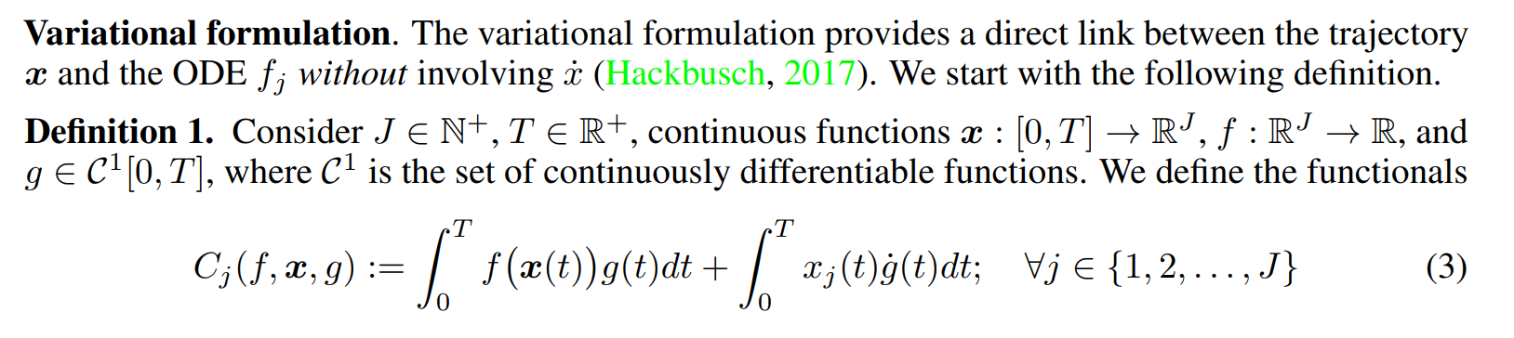
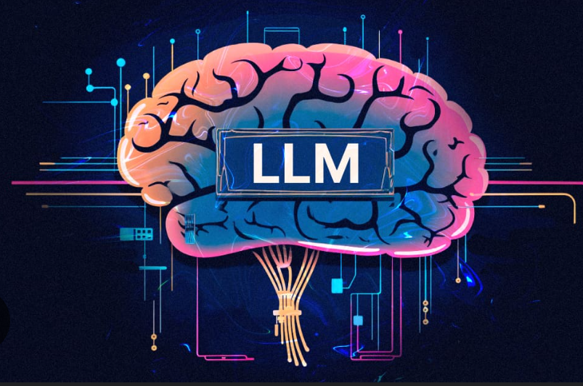


D-CODE: theory
Variational formulation of ordinary differential equations
Natural choice
$$g_{s}\left(t\right)=\sqrt{2/T}sin⁡(sπt/T)$$
vanderschaar-lab.com
Notes:
Instead it involves the derivative of g.
If we Choose g in such a way that the derivative is easy to compute then calculating the whole functional also should not be challenging

Slide 22
LLM Agents
LLM Agents: Beyond Text Generation - LLMs That Act
LLMs: Large Language Models that predict text based on input prompts.
LLM Agents: Systems that augment LLMs with:
Context management (memory)
Decision-making (planning, goal-setting)
Actions (tool usage, APIs, environment interaction)
vanderschaar-lab.com
Notes:
I would like to end with a call to action: Let us build AI that is human-empowering

Slide 23
The LLM Agent Loop
Prompt & Context: The agent queries the LLM with a prompt that includes goals, instructions, data etc.
Reasoning: The agent reasons (e.g. CoT) considering multiple steps or sub-tasks.
Action: The agent can execute actions (e.g., call a tool, fetch external info, revise the approach).
Feedback: The agent updates its memory/context with the results of the action.
Iteration: Cycle repeats until the goal is reached (or stopping criterion is met).
Take away: LLM is no longer just a passive language predictor; it’s part of a loop that actively pursues objectives.
vanderschaar-lab.com
Notes:
I would like to end with a call to action: Let us build AI that is human-empowering

Slide 24







D3: A Discovery Agent for Transparent Dynamical Laws
Data-Driven Discovery of Dynamical Systems
using Large Language Models
NeurIPS 2024, Spotlight
Samuel Holt
Zhaozhi Qian
Tennison Liu
Jim Weatherall
Mihaela van der Schaar
vanderschaar-lab.com

Slide 25

Our agent iteratively discovers and refines system dynamics
Given a dataset of trajectories, our agent (D3) can discover a well-fitting model f, either a white-box model or a hybrid model, combining a white-box model with a neural network component fit to residuals.
Notes:
Data-Driven Discovery (D3) Overview. Given a dataset of trajectories of individuals D,
D3 can discover a well-fitting model f, that is either a white-box model or a hybrid model, combining
a white-box model with a neural network component fit to the residuals. First, a user provides a
system description c for the model, which includes the feature names, their units and ranges. The
Modeling agent uses the textual description and generates a model, represented as code. Next, the
Evaluator agent evaluates the generated model on a held-out validation dataset and provides a loss
metric. Next, the Feature Acquisition agent decides if it wants to acquire a new feature, that could aid
in generating better models. This iterative process repeats, when there exists one or more previously
generated models, the Evaluator agent provides a verbal reflection on how the model can be improved,
which is used by the Modeling agent at subsequent iterations. This process repeats, discovering better
fitting models, and after a set number of iterations, the best fitting model is returned, as code with its
parameters optimized to the given training subset of the given dataset D.

Slide 26


New Discovered PK Warfarin Model
Experiments on a real pharmacokinetic Warfarin dataset
D3 uncovers a new plausible pharmacokinetic model
Outperforms existing literature
Highlighting its potential for precision dosing in clinical applications
vanderschaar-lab.com

Slide 27
New Discovered PK Warfarin Model: Expert commentary
Prof. Jean-Baptiste Woillard, Pharmacologist. “The model is promising and pharmacokinetically plausible. The next step is to apply D3 to other clinically relevant PK drug datasets.”
Prof. Richard Peck, Clinical Pharmacologist. “This model is reasonable and potentially superior. It represents a significant advance in clinical pharmacology by automatically identifying robust PK models.”
Prof. Eoin McKinney, Clinician. “This model is significant, as consortiums are dedicated to improving Warfarin [Consortium, 2009]. The model adds novel components, such as the Michaelis component for time-varying changes and novel interaction terms like age-sex.”
vanderschaar-lab.com

Slide 28
Will LLM-Agents replace researchers?
vanderschaar-lab.com
Notes:
Problem first, not method first
Currently the ML world is too much focused on solving “standardized” problems, at times toy problems and focuses on developing incremental methods working on benchmarks
We need a new way of thinking – focused on understanding, formalizing and addressing complex, intricate, real-world problems using AI/ML

Slide 29








A SUPER hard problem
Discovery of governing equations using ML
 | Explicit function | Implicit function | Ordinary differential equation | Partial differential equation
Typical form
Examples | Relativity | Bernoullis’ Eq | Newton’s law | Heat equation
$$y=f(x,t)$$
$$f\left(x, y\right)=c$$
$$\frac{dx}{dt}=f(x,t)$$
$$\frac{∂u}{∂t}=f(u,x)$$
$$m\frac{d^{2}x}{dt^{2}}=F(x)$$
$$\frac{∂u}{∂t}=Δu$$
$$E=m⋅c^{2}$$
$$\frac{v^{2}}{2}+gz+\frac{p}{q}=c$$
vanderschaar-lab.com
Notes:
For centuries, scientists have been … ranging from microscopic quantum interactions to cosmological scale formation of galaxies.
Much of the sci research is conducted with the goal of

Slide 30

Why do we care about PDEs?
While ODEs model time-dependent processes in medicine, PDEs are necessary when spatial variations are important
vanderschaar-lab.com
Notes:
diffusion, transport, propagation

Slide 31













What about higher order ODEs and PDEs?
$$u\frac{∂u}{∂t}$$
$$\frac{∂^{2}u}{∂t^{2}}$$
Difficult to search
$$\frac{∂u}{∂t}$$
$$\frac{∂^{2}u}{∂t∂x}$$
$$u^{2}\frac{∂u}{∂t}$$
Variational trick may not work
$$\frac{du}{dt}$$
$$\frac{∂u}{∂x}$$
$$\frac{∂^{2}u}{∂x^{2}}$$
$$\frac{∂^{2}u}{∂t∂y}$$
Kacprzyk, K., Qian, Z. & vdS
D-CIPHER: Discovery of Closed-form Partial Differential Equations
(NeurIPS 2023)
$$\frac{∂u}{∂y}$$
$$u\frac{∂u}{∂x}$$
$$\frac{∂^{2}u}{∂y^{2}}$$
$$\frac{∂^{2}u}{∂x∂y}$$
Krzysztof Kacprzyk
Zhaozhi Qian

Slide 32

Any PDE: Derivative-bound and derivative-free part
$${f(x,u\left(x\right),∂}^{\left[K\right]}u(x))−g(x,u(x))=0$$
derivative-bound
derivative-free
Requires some technical constraints
for the variational trick to work!
Can be evaluated directly from data –
No additional constraints!
Variational-Ready PDEs
Currently the broadest family of PDEs that admit variational formulation
vanderschaar-lab.com
Notes:
Based on this observation we propose the following characterisation of pdes. Any PDE can be expressed in the following form, where we collect all terms containing derivatives into so-called derivative-bound part and all terms without derivatives into the derivative-free part. Significance - Derivative-free part can be evaluated directly from the data wheres derivative-bound part requires access to derivatives. If we want the PDE to admit the variational formulation, we do not have to put any additional constraints on the derivative-free part. However derivative bound part still requires some technical constraints for the variationl trick to work. We use this novel characterisation of PDEs to define varianal ready PDEs which are currently the broadest family of PDEs that admit variational formulation

Slide 33










D-CIPHER
Kacprzyk, K., Qian, Z. & van der Schaar, M.
D-CIPHER: Discovery of Closed-form Partial Differential Equations. (NeurIPS 2023)
Algorithm
Uses variational formulation
Searches through all closed-form derivative-free parts
Searches through a linear subspace of derivative-bound parts
Step 1: Choose the dictionary
$${\left\{{\hat{ℰ}}_{p}\right\}}_{p=1}^{P}$$
$${ ∂}_{t}u$$
Dataset
$$∂_{t}^{2}u$$
$$∂_{t}∂_{x}u$$
${\left\{v^{(d)}\right\}}_{d=1}^{D}$
$$∂_{x}^{2}u$$
$$∂_{x}\left(u^{2}\right)$$
Test functions
Step 2: Estimate the fields
$${\left\{φ_{s}\right\}}_{s=1}^{S}$$
Compute (Eq. 15)
$Z∈ℝ^{DS}×ℝ^{P}$
${\left\{{\hat{u}}^{(d)}\right\}}_{d=1}^{D}$
Step 3: Optimization
Compute (Eq. 15)
Symbolic Regression
$$g:ℝ^{M+N}→ℝ$$
e.g., $\log\left(t\right)e^{x^{2}}sin⁡(u)$
$$w∈ℝ^{DS}$$
CoLLie
Loss
$$\min_{{\left\|β\right\|}_{1}=1}{{\left\|Zβ−w\right\|}_{2}}$$
vanderschaar-lab.com
Notes:
Searches through a linear subspace of derivative bound parts as searching through the whole space would be intractable.
D-CIPHER consists of 3 steps. In Step 1 we choose the dictionary of derivative terms that form the basis for the space of derivative bound parts. This usually inlcudes standard partial derivatives of various orders, mixed derivative and even more complicated expression such as derivative of a square of the function. Then we take our dataset and in Step 2 we estimate the fields (similarly as it was done in D-CODE). Then we take our predefined testing functions and compute certain integral expression involving derivatives of testing functions as specified in the dictionary. All of this can be deemed preprocessing. Finally we get to step 3 – the actual optimization. Similarly to D-CODE we use a symbolic regression algorithm to suggest a closed-form function for the derivative free part. Then we apply it to the estimated fields and try to optimize a corresponding derivative-bound part. This can be formulated as a constrained linear least squares problem and we designed and heuristic algorithm – CoLLie that solves this problem very eficiently. Then we pass the loss back to the symbolic regression algorithm.

Slide 34
Do we need Equations to Understand Dynamical Systems?
Kacprzyk, K., & van der Schaar, M. (2025).
No Equations Needed: Learning System Dynamics Without Relying on Closed-Form ODEs.
ICLR 2025.
Krzysztof Kacprzyk
vanderschaar-lab.com

Slide 35


Do we need Equations? Why Equations?
Syntactic representation
Logistic growth model
analysis
system behavior
Semantic representation
vanderschaar-lab.com
Notes:
Logistic growth model

Slide 36



















Syntactic vs. Semantic representation of an ODE
Syntactic representation
Semantic representation
Inflection point
$${0≤x}_{0}<1.4$$
$${1.4≤x}_{0}<2.8$$
$$x_{0}=2.8$$
$${2.8<x}_{0}$$
Mid-point
$$(ρ(x_{0}),1.4)$$
$$x(t)$$
$$x(t)$$
$$x(t)$$
$$x(t)$$
$$\left(ο(x_{0}), {x_{0}}/2+1.4\right)$$
$$\dot{x}\left(t\right)=x(t)\left(1−\frac{x(t)}{2.8}\right)$$
$$x\left(0\right)=x_{0}$$
$$ρ(x_{0})$$
$$ο(x_{0})$$
$$2.8$$
$$ln(2)$$
$$0.0$$
$$0.0$$
$$0.0$$
$$0.0$$
$$x_{0}$$
$$1.4$$
$$0.0$$
$$t$$
$$0.0$$
$$t$$
$$0.0$$
$$t$$
$$0.0$$
$$t$$
$$2.8$$
$$x_{0}$$
$$\lim_{x_{0}→0^{+}}{ρ\left(x_{0}\right)=+∞}$$
$$\lim_{t→+∞}{x\left(t\right)=2.8}$$
$$\lim_{x_{0}→∞}{ο\left(x_{0}\right)=0}$$
Semantic representation:
behaviour of a dynamical system
Semantic representation of a forecasting model, including a system of ODEs, describes changes under different initial cdts
symbolic form
shape, properties, asymptotic behavior
how they change under different conditions
vanderschaar-lab.com
Notes:
Logistic growth model, with some initial condition
The semantic representation of the dynamic forecasting model, because
every ODE has its own associated forecasting model, where we can start with an initial condition, and solve the IVP to get the whole trajectory
So in that case we can see for different initial cdts how the shape of the trajectory looks like
We can slo go deeper and analyse the asymptotic property when times goes to infinity, we can also look at inflection points and how they change with different initial cdts or maybe how the midpoint changes as well
So to summarize, we often in ODE discovery focus on discovering these equations but actually what we really want is to unravel these semantic representations

Slide 37
Syntactic vs. Semantic representation of an ODE
Syntactic representation
Semantic representation
Inflection point
$${0≤x}_{0}<1.4$$
$${1.4≤x}_{0}<2.8$$
$$x_{0}=2.8$$
$${2.8<x}_{0}$$
Mid-point
$$(ρ(x_{0}),1.4)$$
$$x(t)$$
$$x(t)$$
$$x(t)$$
$$x(t)$$
$$\left(ο(x_{0}), {x_{0}}/2+1.4\right)$$
$$\dot{x}\left(t\right)=x(t)\left(1−\frac{x(t)}{2.8}\right)$$
$$x\left(0\right)=x_{0}$$
$$ρ(x_{0})$$
$$ο(x_{0})$$
$$2.8$$
$$ln(2)$$
$$0.0$$
$$0.0$$
$$0.0$$
$$0.0$$
$$x_{0}$$
$$1.4$$
$$0.0$$
$$t$$
$$0.0$$
$$t$$
$$0.0$$
$$t$$
$$0.0$$
$$t$$
$$2.8$$
$$x_{0}$$
$$\lim_{x_{0}→0^{+}}{ρ\left(x_{0}\right)=+∞}$$
$$\lim_{t→+∞}{x\left(t\right)=2.8}$$
$$\lim_{x_{0}→∞}{ο\left(x_{0}\right)=0}$$
The focus is often on discovering equations …
and yet, what we actually want is to unravel these semantic representations
vanderschaar-lab.com
Notes:
Logistic growth model, with some initial condition
The semantic representation of the dynamic forecasting model, because
every ODE has its own associated forecasting model, where we can start with an initial condition, and solve the IVP to get the whole trajectory
So in that case we can see for different initial cdts how the shape of the trajectory looks like
We can slo go deeper and analyse the asymptotic property when times goes to infinity, we can also look at inflection points and how they change with different initial cdts or maybe how the midpoint changes as well
So to summarize, we often in ODE discovery focus on discovering these equations but actually what we really want is to unravel these semantic representations

Slide 38















From Discovery and Analysis to Direct Semantic Modeling
Two-step modelling (traditional)
Direct semantic modelling (ours, no equations)
Prior knowledge
Prior knowledge
Difficult to inject
Challenging to edit
Easy to inject
Edit
Dataset
Fitting
Predictive model
Dataset
Fitting
Determines
Predictive model
Human analysis
$$\dot{x}\left(t\right)=x(t)\left(1−x(t)\right)$$
(may be complex)
Semantic
representation
Semantic
representation
Cannot provide feedback!
Provide feedback
Solve IVP
(e.g., forward Euler method)
Initial value
$$x\left(t_{0}\right)=x_{0}$$
Trajectory
$$x:𝒯→ℝ$$
Initial value
$$x\left(t_{0}\right)=x_{0}$$
$$F_{sem}$$
$$F_{traj}$$
Trajectory
$$x:𝒯→ℝ$$
Semantic
representation of $x$
Predict
Match
What do we mean by semantic representation?
vanderschaar-lab.com
Notes:
A way of getting semantic representation using ODE discovery in 2 steps
Fitting: ODE discovery
Human analysis – may be even intractable in the eq is too complex
Prior knowledge:
Difficult to inject prior knowledge because we may have prior knowledge about the phenomena but not necessarily the eq
May be difficult to know if there is a certain term that we want to include
Challenging to edit:
Maybe you analyzed and you want to change it because you do not like the behavior, or the behavior does not correspond with what you expect; adding or substracting a term or changing a coefficient is difficult
Similarly providing feedback to the optimization algorithm is also quite difficult
Semantic modelling
We use the data to directly fit the dynamic representation of the dynamical system
Only later this dynamic representation determines the predictive model that we use for forecasting etc.
Main difference between these 2 models is how the predictive modelling works.
In ODE discovery
In our case, we use a semantic predictor to predict the semantic representation of a trajectory and then we use the semantic predictor to actually match this semantic representation to the trajectory
This is the general framework, but now we will show a specific example: semantic ODES
To do se we need to explain what does it mean to create a semantic representation of a trajectory.
Fortunately, we recently developed timeview

Slide 39





Formalizing Semantic Representations: Shape of trajectory
Kacprzyk, Liu, vdS, Towards Transparent Time Series Forecasting. ICLR 2024
2
1
3
5
4
Krzysztof Kacprzyk
Divide the shape of trajectory into smaller intervals
where the trajectory has a particular shape, called motifs
Motifs:
$s_{+−b}$
increasing
concave
$$s_{−−b}$$
decreasing
concave
$$s_{−+b}$$
decreasing
convex
$$s_{++b}$$
increasing
convex
Composition:
$$(s_{+−b},s_{−−b},s_{−+b},s_{++b})$$
Transition points:
1
2
3
4
5
start
local
maximum
Inflection
point
local
minimum
end
vanderschaar-lab.com
Notes:
Semantic representation: Shape of a trajectory
Divide it into smaller intervals where the trajectory has a particular shape – called motifs
A sequence of these motifs we call a composition
This represents the general shape of the trajectory
More generally, transition points between motifs which can be mapped to ….and are of great interest in modelling trajectories
In the semantic ODE we borrow this framework we already developed but we extended it a little to add motifs that describe unbounded trajectories because in ODES awe are interested also in the long-term behavbior of a system, not just on some bounded domain, we also added motifs to describve if the system approaches an asymptote or not

Slide 40

Formalizing Semantic Representations: Shape of trajectory
Kacprzyk, Liu, vdS, Towards Transparent Time Series Forecasting. ICLR 2024
In semantic ODEs, we extended this framework to add motifs that describe unbounded trajectories
Krzysztof Kacprzyk
vanderschaar-lab.com
Notes:
Semantic representation: Shape of a trajectory
Divide it into smaller intervals where the trajectory has a particular shape – called motifs
A sequence of these motifs we call a composition
This represents the general shape of the trajectory
More generally, transition points between motifs which can be mapped to ….and are of great interest in modelling trajectories
In the semantic ODE we borrow this framework we already developed but we extended it a little to add motifs that describe unbounded trajectories because in ODES awe are interested also in the long-term behavbior of a system, not just on some bounded domain, we also added motifs to describve if the system approaches an asymptote or not

Slide 41




Formalizing Semantic Representations: Recap
$$c_{x}$$
Composition: | $$(s_{++b},s_{+−h})$$
Transition points: | $$\left(0,0.4\right),(1.8,1.4)$$
Derivatives: | $$\dot{x}\left(t_{0}\right)=0.3,\dot{x}\left(t_{1}\right)=0.7, \ddot{x}\left(t_{1}\right)=0$$
Properties of $s_{+−h}$: | $$h=2.8,t_{1/2}=2.9$$
Semantic representation of $x$
$$p_{x}$$
vanderschaar-lab.com
Notes:
Composition and properties px (e.g. horizontal asymptops)

Slide 42










How do we build Semantic ODEs?
Initial condition
Semantic predictor
Semantic representation of $x$
Trajectory predictor
Trajectory
Composition: | $$(s_{++b},s_{+−h})$$
Transition points: | $$\left(0,0.4\right),(1.8,1.4)$$
Derivatives: | $$\dot{x}\left(t_{0}\right)=0.3,\dot{x}\left(t_{1}\right)=0.7, \ddot{x}\left(t_{1}\right)=0$$
Properties of $s_{+−h}$: | $$h=2.8,t_{1/2}=2.9$$
$$x=2.8$$
$$x(0)=0.4$$
$$F_{sem}$$
$$F_{traj}$$
$$x$$
$$(1.8,1.4)$$
$$(0.0,0.4)$$
$$t$$
$$F_{com}$$
$$F_{prop}$$
vanderschaar-lab.com
Notes:
Fsem – two smaller predictors, F com predicts the compositions and F prop predicts the properties of the trajectories

Slide 43













Semantic Inductive Biases
Concentration
$$t$$
ODE discovery
Semantic ODE
Semantic motifs
$$\dot{x}\left(t\right)=\sum_{i=1}^{n}{α_{i}g_{i}(t)}$$
$n≤$5
$$(s_{−+h})$$
$$(s_{−−b},s_{−+h})$$
$$(s_{+−b},s_{−−b},s_{−+h})$$
$$n≤10$$
$$({s_{−+b},s}_{−−b},s_{−+h})$$
$$(s_{++b},s_{+−b},s_{−−b},s_{−+h})$$
$$xt$$
$x^{3}$
$x^{2}$
Can select number and types of motifs
$log(t)$
vanderschaar-lab.com
Notes:
Traidtional way: ODE discovery; ODE is a linear combination of terms (like Syndy assumes); how long should the equation be, what terms to use
Let us make the eq simple enough so that we can understand it
While in our case, we can focus on the semantic motifs
Incorporating inductive biases
In the long term should decay to zero; decreasing convex motifs decaying to zero
We can also a small number of motifs

Slide 44



Comprehensibility
vanderschaar-lab.com
Notes:
You can edit the model
The model should decay to zero; fixing this asymptote to be zero

Slide 45

Editing
Edit and retrain our model while fixing this asymptote to 0
vanderschaar-lab.com
Notes:
Edit and retrain our model while fixing this asymptote to zero

Slide 46


Extrapolation
Extrapolation for different inputs,
outside training domain
Great performance without seeing without a single sample from this distribution
vanderschaar-lab.com
Notes:
Extrapolation
We have already shown extrapolation in time domain
Now is extrapolation for different inputs, trained between 0 and 1, but then extrapolate for inputs outside of the training domain; has this performance without seeing without a single sample from this distribution

Slide 47

Flexibility
Not only closed formed ODEs!
vanderschaar-lab.com
Notes:
Not only closed formed ODEs, Integro-DE
Things like Sindy do not work
Our method performs better than black box ODEs

Slide 48
This talk
We are entering a new paradigm of discovery, driven not by static models or datasets, but by AI agents capable of reasoning, experimentation, and evolving knowledge, transforming science from human-centric to co-creative
LLM-based AI Agents
Why are they exciting
Examples
Genies: Next-generation AI Agents
vanderschaar-lab.com
Notes:
I would like to end with a call to action: Let us build AI that is human-empowering

Slide 49



Genies – The Future of AI Agents
https://www.vanderschaar-lab.com/genies-the-future-of-ai-agents/
vanderschaar-lab.com

Slide 50
Introducing Genies: Next-generation AI agents
What Are Genies?
Sophisticated, multi-capable AI “companions” that generate ideas, plan strategies, reason adaptively, and learn continuously.
Designed to amplify human potential rather than replace it.
Goal
Empower humans through collaboration, trust, and transparent decision-making.
Move beyond narrow task automation or purely reactive “agents.”
vanderschaar-lab.com
Notes:
I would like to end with a call to action: Let us build AI that is human-empowering

Slide 51
Genies: The Synergy Loops
Five Interconnected Steps
Innovation: Generating novel ideas, challenging assumptions.
Operation: Planning and executing complex strategies.
Validation: Rigorous reasoning and testing outcomes.
Evolution: Continuous communication and learning.
Empowerment: Building trust, expanding human abilities.
Self-Improving Cycle
Each step reinforces the others, allowing genies to adapt over time.
Designed for long-term partnership with humans (and other genies).
vanderschaar-lab.com
Notes:
I would like to end with a call to action: Let us build AI that is human-empowering

Slide 52
Genies – Core Capabilities
Generate & Innovate
Empower Humans
Plan
Act
Continuously
Learn
Reason and Validate
Communicate
Build Trust &
Foster Transparency
vanderschaar-lab.com
Notes:
7. Genies must transcend conventional transparency and interpretability by engaging in dynamic, context-aware communication that adapts to diverse users, varying expertise levels, and different collaboration settings.
5. Genies must be able to effectively communicate - engage in dynamic, context-aware dialogues with both humans and other agents, ensuring that their communication serves multiple critical functions: supporting planning and execution, facilitating knowledge exchange, uncovering the capabilities of other genies, sharing data, and enhancing creativity.
6. Genies must be lifelong learners—constantly assimilating new information, refining their models, and evolving their capabilities to remain effective in dynamic, complex environments.
8. Genies must empower, they are designed not to replace human effort but to empower individuals to achieve greater heights—paving the way for innovation, co-creation, co-reasoning, and co-acting on a scale that neither humans nor AI could achieve alone.

Slide 53
LLM Agents vs Genies
Aspect | LLM Agent | Genie
Primary Focus | Language-driven task execution | Multi-capable synergy (ideas, plans, validation, etc.)
Adaptation | Often short-term or prompt-based | Lifelong, evolving with user & environment
Memory | Limited context window or ephemeral tools | Persistent, structured, continuously integrated knowledge
Innovation | Usually reliant on user prompt or fine-tunes | Proactively generates novel strategies & creative solutions
Human Role | User queries, agent responds | Collaborative co-creation and empowerment
Genies aim for comprehensive, long-term synergy with humans, not just short bursts of text-based help.
vanderschaar-lab.com
Notes:
I would like to end with a call to action: Let us build AI that is human-empowering

Slide 54



A challenging agenda
Answering each question is a PhD thesis
vanderschaar-lab.com

Slide 55
Why We Should Be Excited: Shaping the Future of AI + Human Collaboration
Transformative Partnerships
Genies expand what’s possible: advanced healthcare support, scientific discovery, personalized education, etc.
Continuous Improvement
Self-evolving loop ensures ongoing value rather than “one-and-done” or static solutions.
Potential Impacts
Research & Innovation: New breakthroughs via cross-domain synergy.
Everyday Life: Personal genies that evolve with your career, health, and creative pursuits.
vanderschaar-lab.com
Notes:
I would like to end with a call to action: Let us build AI that is human-empowering

Slide 56
This talk
We are entering a new paradigm of discovery, driven not by static models or datasets, but by AI agents capable of reasoning, experimentation, and evolving knowledge, transforming science from human-centric to co-creative
LLM-based AI Agents
Why are they exciting
Examples
Genies: Next-generation AI Agents
Agent Networks
vanderschaar-lab.com
Notes:
I would like to end with a call to action: Let us build AI that is human-empowering

Slide 57



The Agent Network
https://www.vanderschaar-lab.com/the-agent-network/
vanderschaar-lab.com

Slide 58




Rethinking Scientific Discovery using AI Agent Networks
Tennison Liu
Silas Estevez
David Bentley
Mihaela
van der Schaar
vanderschaar-lab.com
Notes:
I would like to end with a call to action: Let us build AI that is human-empowering

Slide 59
Rethinking Scientific Discovery: Why Hypothesis Hunting Needs AI Agents
Modern science faces a crisis of complexity
Scale: Millions of data points × thousands of variables = combinatorial explosion
Coordination: Knowledge, tools, and perspectives scattered across disciplines
Human bottleneck: Limited capacity for exhaustive exploration and synthesis
Scale + Coordination → Beyond Human Reach Alone
The Opportunity: Autonomous, evolving networks of AI agents can – explore vast hypothesis spaces, – iteratively refine candidate findings, – accumulate and share knowledge, surfacing testable hypotheses for human interpretation and experimental validation.
vanderschaar-lab.com
Notes:
I would like to end with a call to action: Let us build AI that is human-empowering

Slide 60
Beyond Today’s “AI Scientists”: Why We Need True Hypothesis-Hunting Agents
Recent systems like AI Scientists and Co-Scientists (Lu et al., 2024; Gottweis et al., 2025) represent important progress - can propose hypotheses, design experiments, run analyses, and interpret results
Limitations of Current AI Scientist Paradigm:
Predefined Questions → operate within narrow, human-specified problem scopes
Limited Exploration → insufficient coverage of vast, sparse hypothesis spaces
Weak Evaluation → struggle to assess significance without a fixed question context
No Cumulative Knowledge → focus on isolated outputs, not evolving, layered research programs
Notes:
I would like to end with a call to action: Let us build AI that is human-empowering

Slide 61
Beyond Today’s “AI Scientists”: Why We Need True Hypothesis-Hunting Agents
What Hypothesis Hunting Requires:
Exploration – search vast, open-ended hypothesis spaces
Evaluation – assess heterogeneous, context-dependent discoveries
Accumulation – refine, layer, and recombine findings into evolving programs
Evolution – adapt reasoning as knowledge grows
We need agents that don’t just answer our questions — they help us find the questions worth asking
vanderschaar-lab.com
Notes:
I would like to end with a call to action: Let us build AI that is human-empowering

Slide 62
How can we unlock Hypothesis Hunting at Scale?
Insight: Scientific progress emerges from networks, not individuals. To advance systematic discovery, we need networks of autonomous AI agents, not solitary ones.
In human science, breakthroughs arise from:
Diverse perspectives across domains
Cross-pollination of methods and ideas
Critical debate and iterative refinement
Cumulative evidence built across time
Their social dynamics — exploration diversity, critique, knowledge exchange — are crucial to uncover novel directions and accumulate layered understanding.
We aim to replicate and amplify these dynamics in AI agentic systems.
vanderschaar-lab.com
Notes:
I would like to end with a call to action: Let us build AI that is human-empowering

Slide 63

Hypothesis Hunting with Evolving Networks of Autonomous Scientific Agents
Large-scale datasets are explored by autonomous networks of research agents that collaborate, peer-review, and refine findings to surface promising directions for human validation
vanderschaar-lab.com
Notes:
I would like to end with a call to action: Let us build AI that is human-empowering

Slide 64
Our Framework: AScience
AScience formalizes hypothesis hunting as a continuous, open-ended exploration process, embedding the social dynamics of cumulative scientific progress.
Key elements:
Distributed agents exploring diverse directions
Endogenous interaction (sharing, critique, refinement)
Shared evaluation frameworks for coherence
Iterative accumulation of knowledge into evolving research programs
Social dynamics unlock collective intelligence in scientific discovery.
vanderschaar-lab.com
Notes:
I would like to end with a call to action: Let us build AI that is human-empowering

Slide 65
Implementation: ASCollab
AScience instantiated as ASCollab, a network of heterogeneous LLM-based research agents, that:
Generate and test hypotheses
Critique and refine one another’s findings
Share evaluation standards
Build cumulative knowledge collaboratively
vanderschaar-lab.com
Notes:
I would like to end with a call to action: Let us build AI that is human-empowering

Slide 66

ASCollab: Paving the way for scalable, directed & open-ended hypothesis hunting
Notes:
I would like to end with a call to action: Let us build AI that is human-empowering

Slide 67
The Cancer Genome Atlas (TCGA): A Prime Testbed for Autonomous Hypothesis Discovery
TCGA offers an ideal environment to evaluate ASCollab’s ability to discover novel, meaningful hypotheses from large-scale, real-world biomedical data.
Why TCGA?
Real-World Impact
Understanding new mechanisms, biomarkers, and therapeutic targets in cancer remains a major open challenge.
Hypotheses uncovered here can drive scientific insight and clinical translation.
2. Scale & Richness
Multi-omics data across dozens of cancer types.
Vast, sparsely explored combinatorial space of possible associations & mechanistic hypotheses.
3. Reproducibility
Open-access resource ensures findings can be validated and compared by the community.
vanderschaar-lab.com
Notes:
I would like to end with a call to action: Let us build AI that is human-empowering

Slide 68
ASCollab Demonstrates Promise for Hypothesis Hunting at Scale
Can a ASCollab surface novel, interpretable, and biologically meaningful hypotheses (discoveries) from TCGA data?
Representative Discoveries found via ASCollab:
Rediscoveries of established cancer drivers → validation of the system’s reliability and grounding in known biology
Extensions of pathways → novel mechanistic insights building on emerging literature
Proposals of new candidate therapeutic targets → previously unexplored associations with survival outcomes
These preliminary results showcase how networked scientific agents can
navigate high-dimensional biomedical data
surface interpretable, biologically plausible, and clinically relevant hypotheses
bridge discovery and translational insight at unprecedented scale
vanderschaar-lab.com
Notes:
I would like to end with a call to action: Let us build AI that is human-empowering

Slide 69


Slide 70
A fundamentally new paradigm is needed for AI to orient it towards addressing the complexities of the real-world
vanderschaar-lab.com

Slide 71
Genies – The Future of AI Agents
https://www.vanderschaar-lab.com/genies-the-future-of-ai-agents/
vanderschaar-lab.com

Slide 72
PhD Opportunities at the van der Schaar Lab
We are looking for 4 fully funded PhDs to join our lab! Applications now OPEN!
About our PhD programme
Based at the University of Cambridge (DAMTP)
Work at the cutting edge in a world-leading lab
Projects with a purpose; work that can change the world
32 papers accepted at four largest AI/ML conferences (NeurIPS, ICML, ICLR, AISTATS) in the past year
Join our PhD Open Day
Monday 20 October, 9:30am (BST) (virtual)
Hear from current PhD students, explore research areas, and ask questions
Apply through our website:
www.vanderschaar-lab.com/join-the-van-der-schaar-lab/
Scan the QR code to register for the PhD Open Day:
For any queries, please email: vanderschaarlab@damtp.cam.ac.uk
vanderschaar-lab.com

Slide 73
Let’s shape the future together!
Mihaela van der Schaar, FRS John Humphrey Plummer Professor of Machine Learning, Artificial Intelligence and Medicine, University of Cambridge
Director, Cambridge Center for AI in Medicine
mv472@cam.ac.uk
@MihaelaVDS
vanderschaar-lab.com
linkedin.com/in/ mihaela-van-der-schaar/

